Slide 1

Implementing Comprehensive Blockchain Based Framework for Transparent Real Estate Transactions
Group No. 1
Amit Pandey 18104020
Aditya Shinde 18104032
Rajan Khade 18104020
Project Guide and Co-guide
Prof. Neha Deshmukh and Prof. Vidya Shet
Notes:
<number>

Slide 2
Contents
Introduction
Objectives
Problem Definition
Technological Stack
Review Suggestions
Proposed System Architecture/Working
Prototype Design Demonstration
Implementation Status
Status of Paper Draft & Targeted Conference
Notes:
<number>

Slide 3
Introduction
Problem Identified :
The Involvement of middlemen and brokers.
The increasing number of fraud cases.
Time Delays and lack of digital protection.
Tax and registration charges.
Solution Proposed :
Blockchain based Platform using Ethereum Blockchain.
Migrate existing data to smart contract.
Storing sensitive data and documents’ hash in Smart Contract (and decentralized storage).
Charges in the form of transaction fees for each operation and Direct buying and selling, without middleman.

Slide 4
Objectives
To make process faster and bring transparency with use of blockchain.
To Reduce the fraud cases.
To reduce extra charges.
To develop a Web Application, which will directly connect user to the blockchain.

Slide 5
Review Suggestions
To add a Government Entity in the process.
To implement security for the stored files.

Slide 6
Technological Stack
Backend – Ethereum, NodeJS
Frontend - React.js, CSS, JavaScript
Database - MongoDB (Future scope - IPFS Storage)
Server Side Frameworks - Express.js
Smart Contract (Deployment and Testing) - Ganache ,Truffle

Slide 7
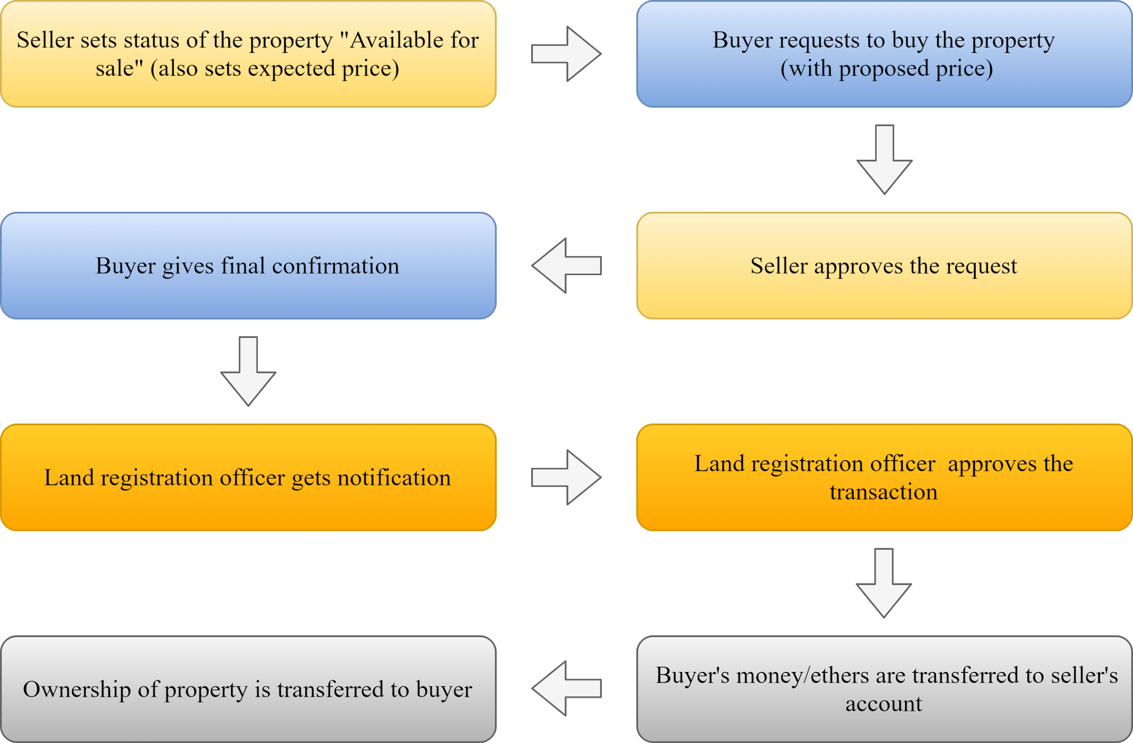
Proposed System Architecture
Figure : New system (After migration), each step is function of smart contract.

Slide 8
Implementation Status
Basic functionalities of smart contract are done
Working on remaining functionalities
Frontend and Backend connection is done
Ethereum network is been deployed on Ganache Blockchain.
Improvement of frontend is ongoing.

Slide 9
Status of Paper Draft & Targeted Conference
Targeted Conferences
IEEE 2021 International Conference on Advances in Computing, Communication and Control, 3rd and 4th December 2021
IEEE International Conference on Computational Intelligence and Computing Applications, 26th and 27th November 2021
Status of Paper Draft
Implementation and conclusion remaining along with Literature

Slide 10
Thank You...!!
Notes:
<number>

